Slide 1
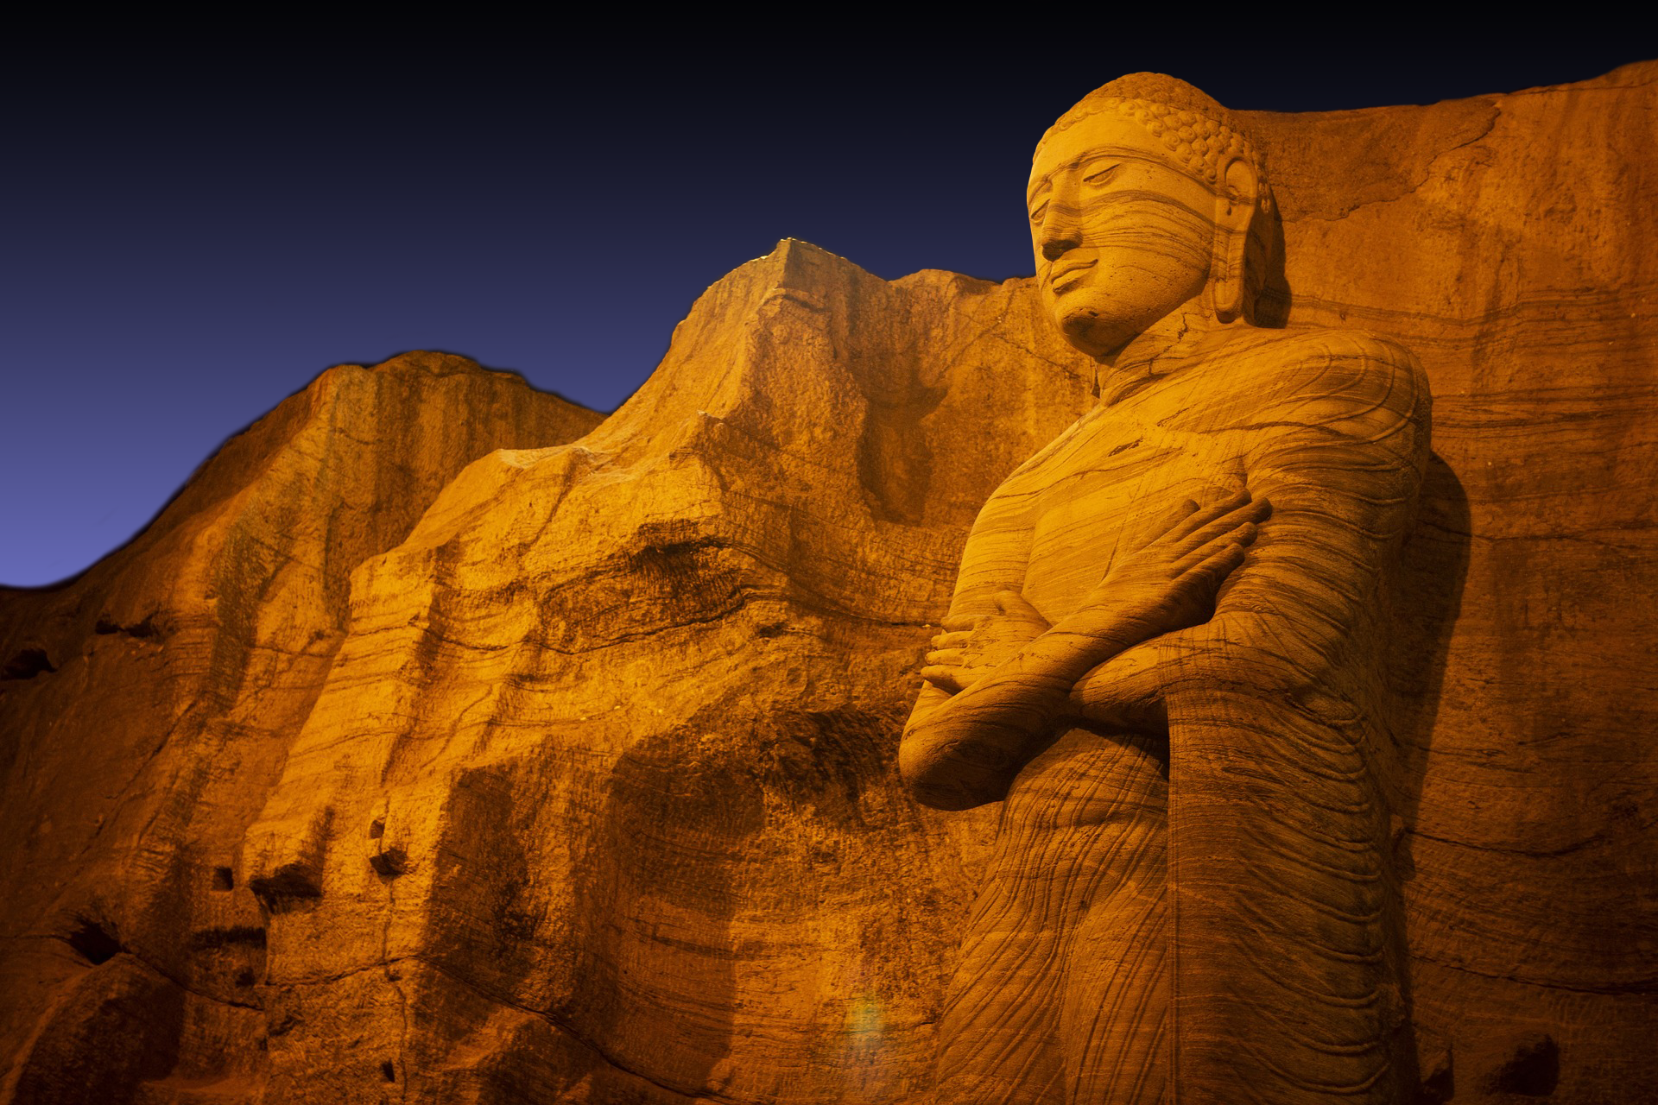

Slide 2
wß wgÕs u.
wßfhda wÜGx.sflda u.af.da
wd¾h wIaGdx.sl ud¾.h

Slide 3
idïm%odhsl foa jeroskï th os.gu lf¾ ordf.k hdu wiQÖ T¨fõ ;ndf.k jeiafia hEu jeksh

Slide 4
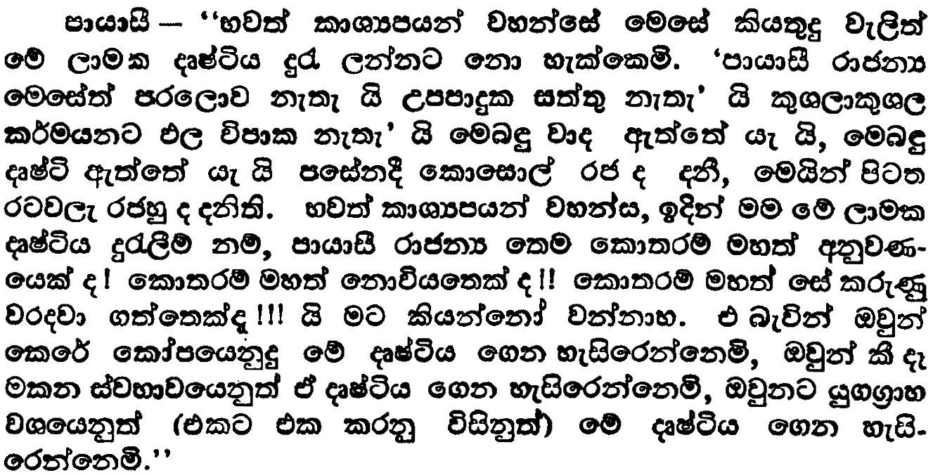
oS.ks. 2
mhdis iQ;%h
msgqj( 549

Slide 5
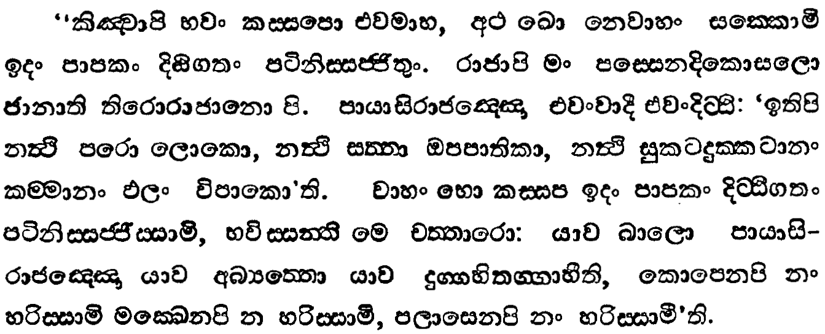
oS.ks. 2
mhdis iQ;%h
msgqj( 548

Slide 6
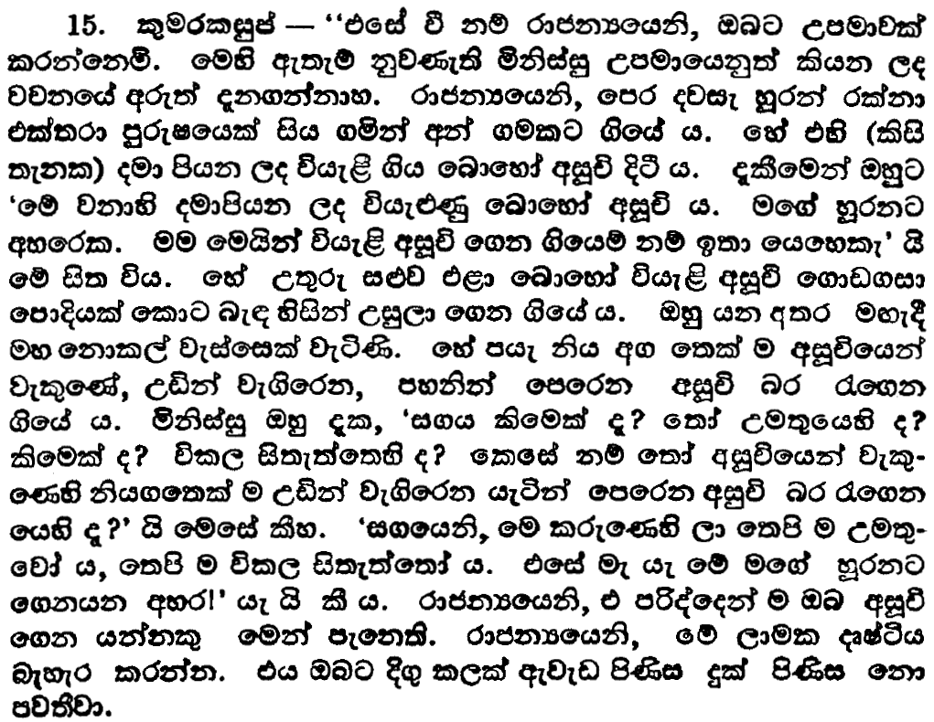
oS.ks. 2
mhdis iQ;%h
msgqj( 549

Slide 7
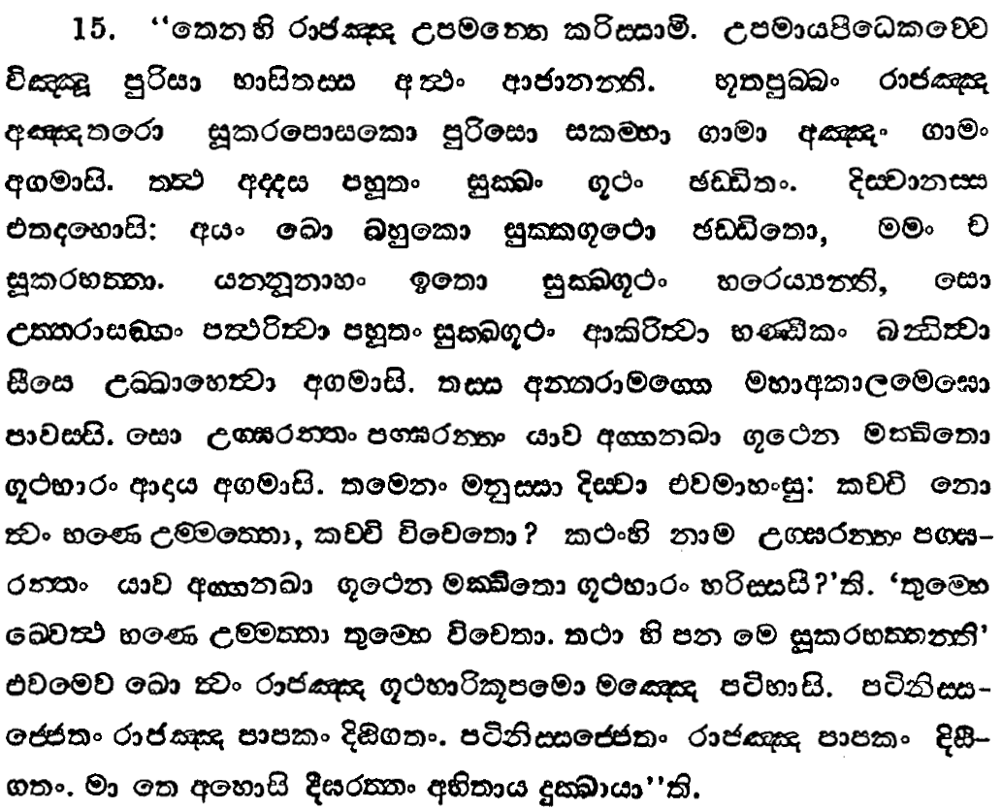
oS.ks. 2
mhdis iQ;%h
msgqj( 548

Slide 8
iïud osÜÀh ish,a,gu mQ¾jdx.u jk nj

Slide 9
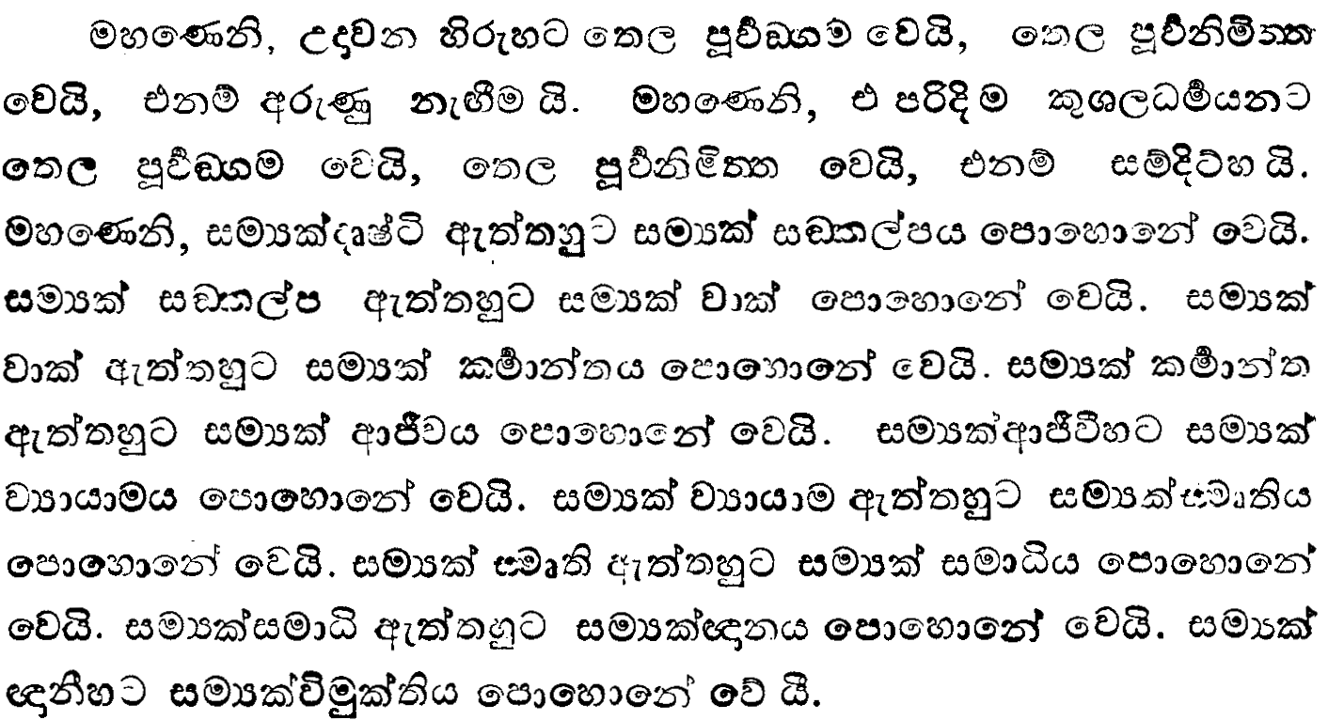
wx.ks. 6
mqínx.u iQ;%h
msgqj( 431

Slide 10
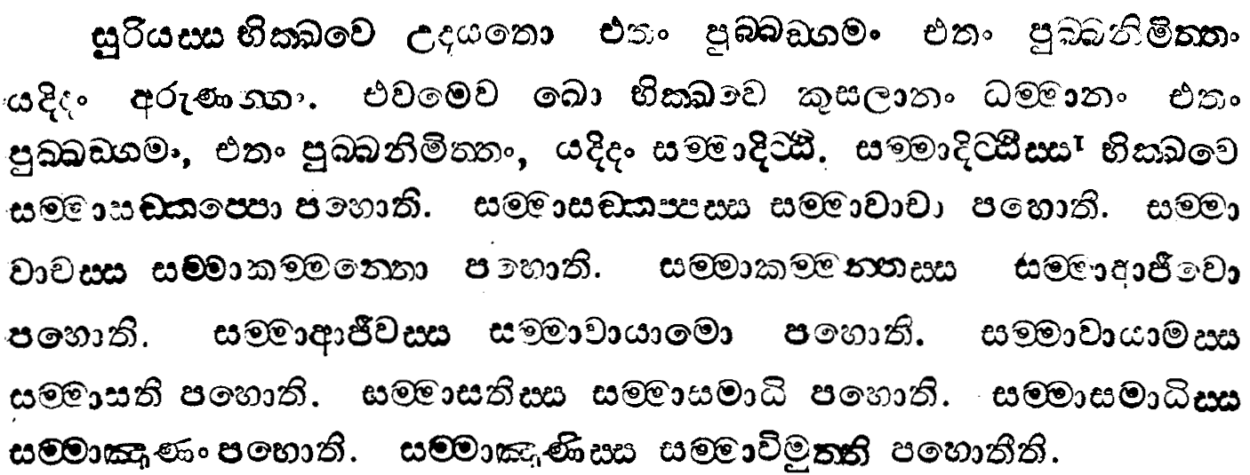
wx.ks. 6
mqínx.u iQ;%h
msgqj( 430

Slide 11
oi jia;=l ñ;Hd oDIaálhd ksjka fkd,nhs

Slide 12
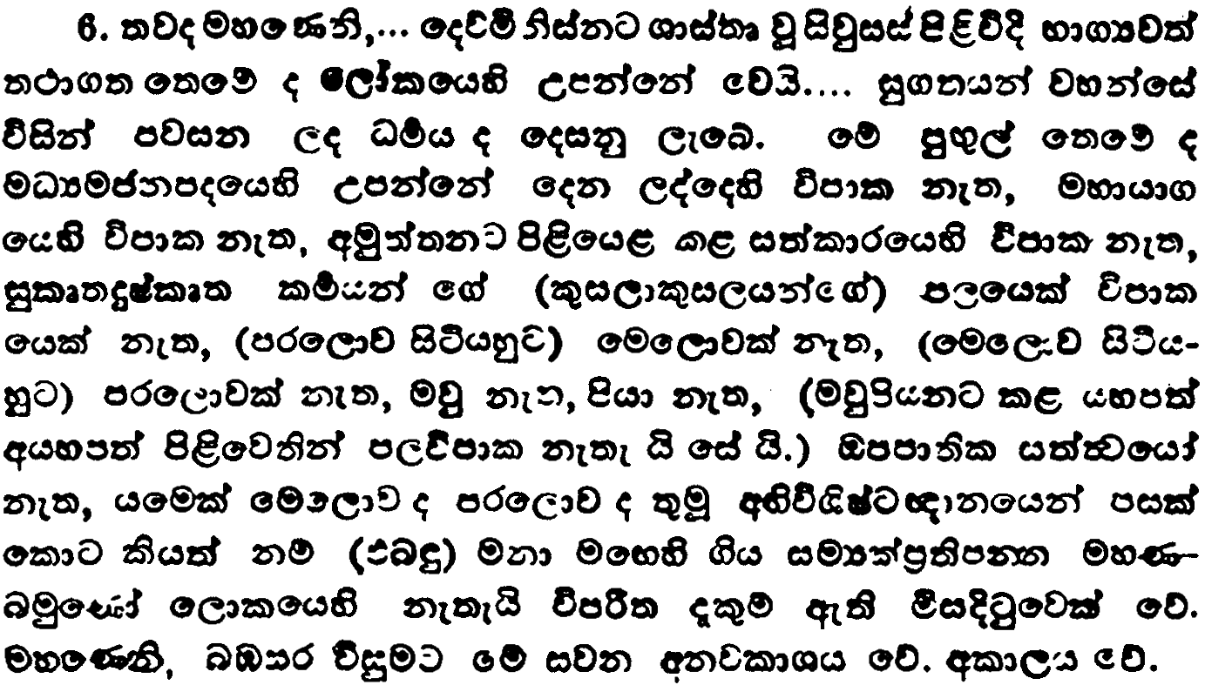
wx.ks. 5
wlaLK iQ;%h
msgqj( 131

Slide 13
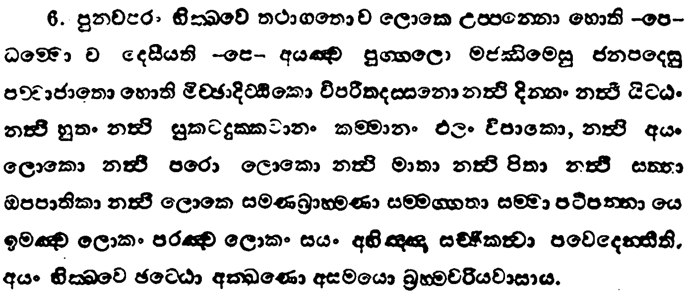
wx.ks. 5
wlaLK iQ;%h
msgqj( 130

Slide 14
osÜÀ iïmkak wd¾h Y%djlhd f.jd y, ÿla m%udKh

Slide 15
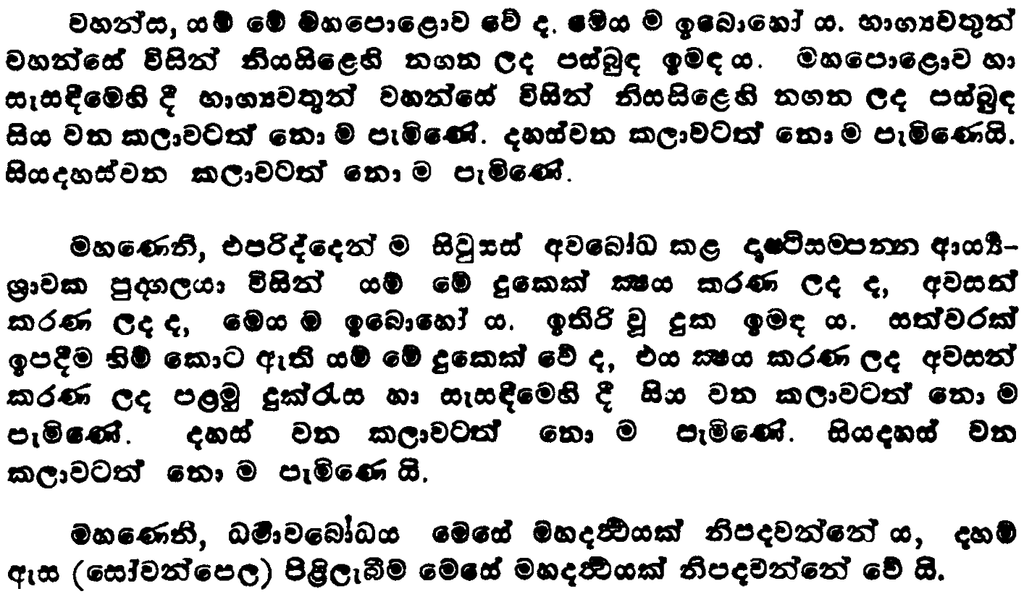
ix.ks. 2
kLisLd iQ;%h
msgqj( 213

Slide 16
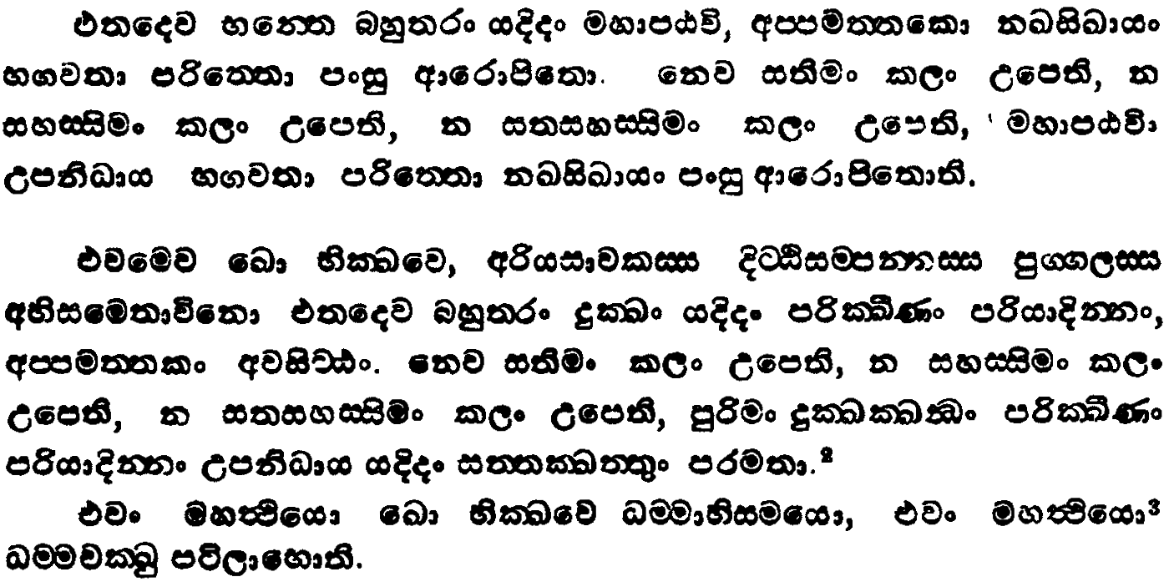
ix.ks. 2
kLisLd iQ;%h
msgqj( 212

Slide 17
ñ:Hd osÜÀh uy fmd<j ;rï flf,ia idohs

Slide 18
iïud osÜÀfha w.h

Slide 19
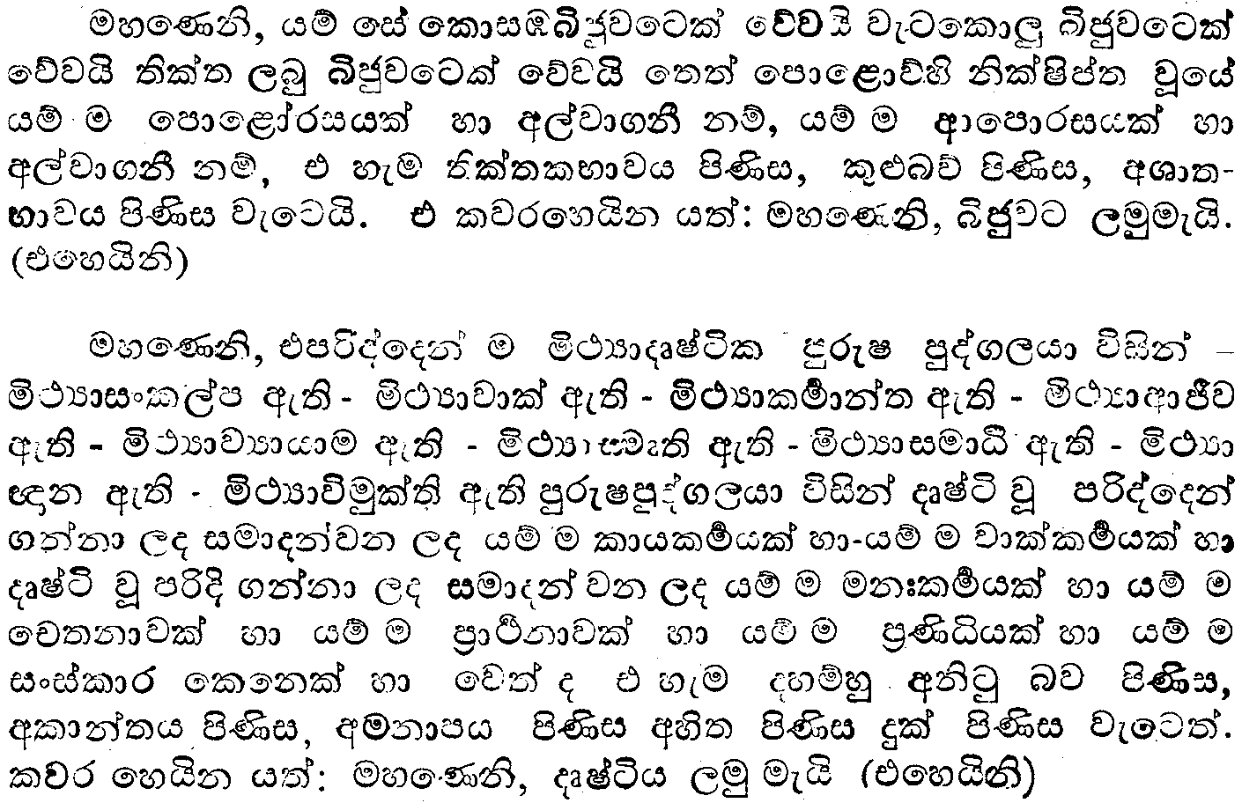
wx.ks. 6
îc iQ;%h
msgqj( 383

Slide 20
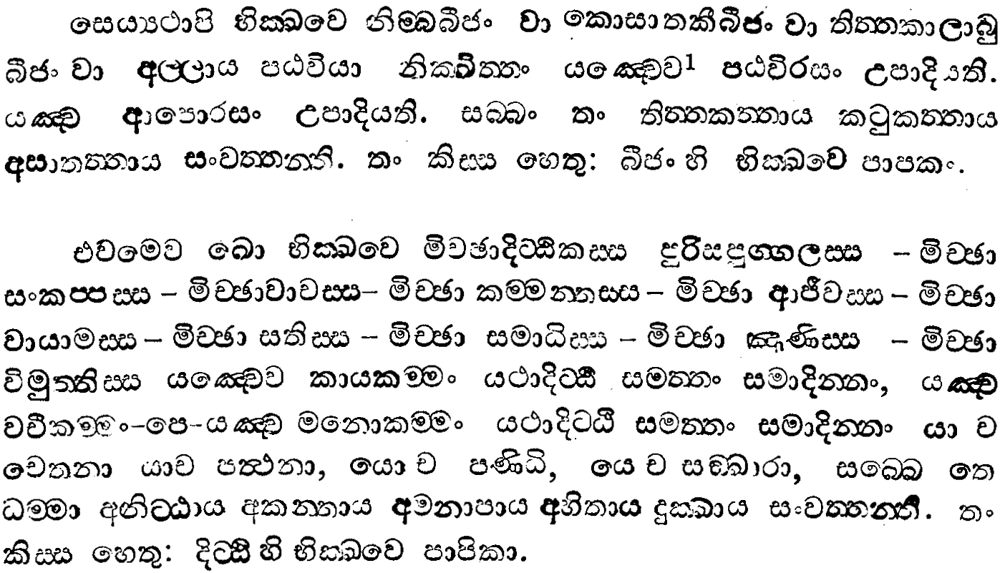
wx.ks. 6
îc iQ;%h
msgqj( 382

Slide 21
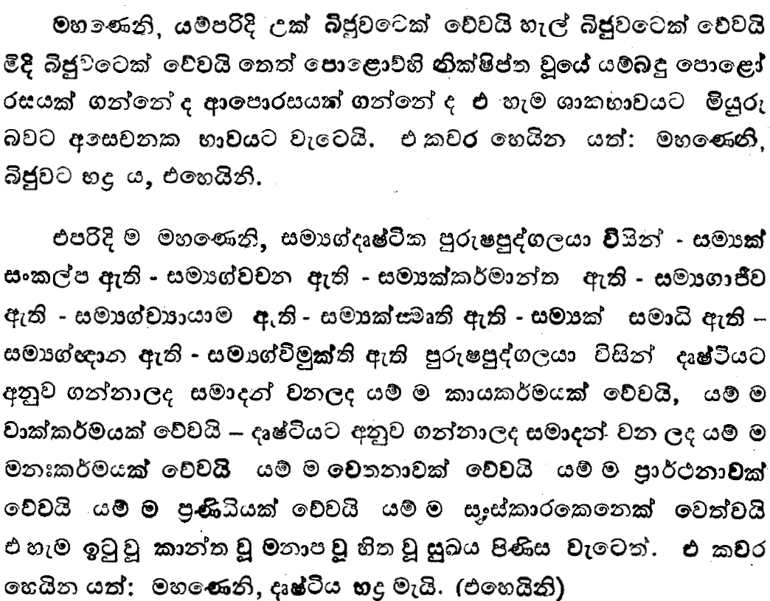
wx.ks. 6
îc iQ;%h
msgqj( 385

Slide 22
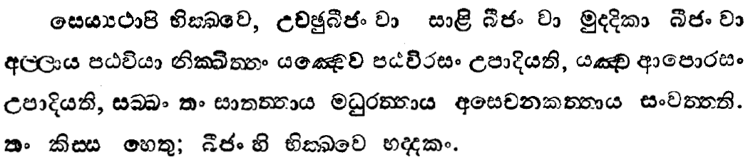
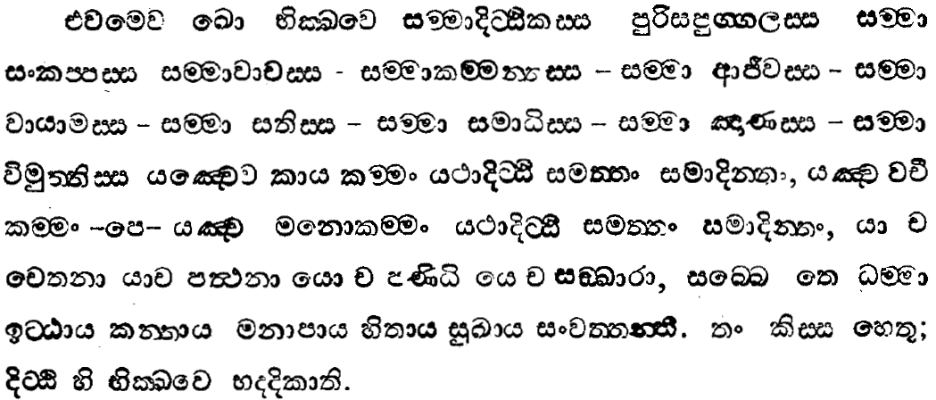
wx.ks. 6
îc iQ;%h
msgqj( 384

Slide 23
iïud osÜÀlhdf.a fkdief<k iajNdjh

Slide 24
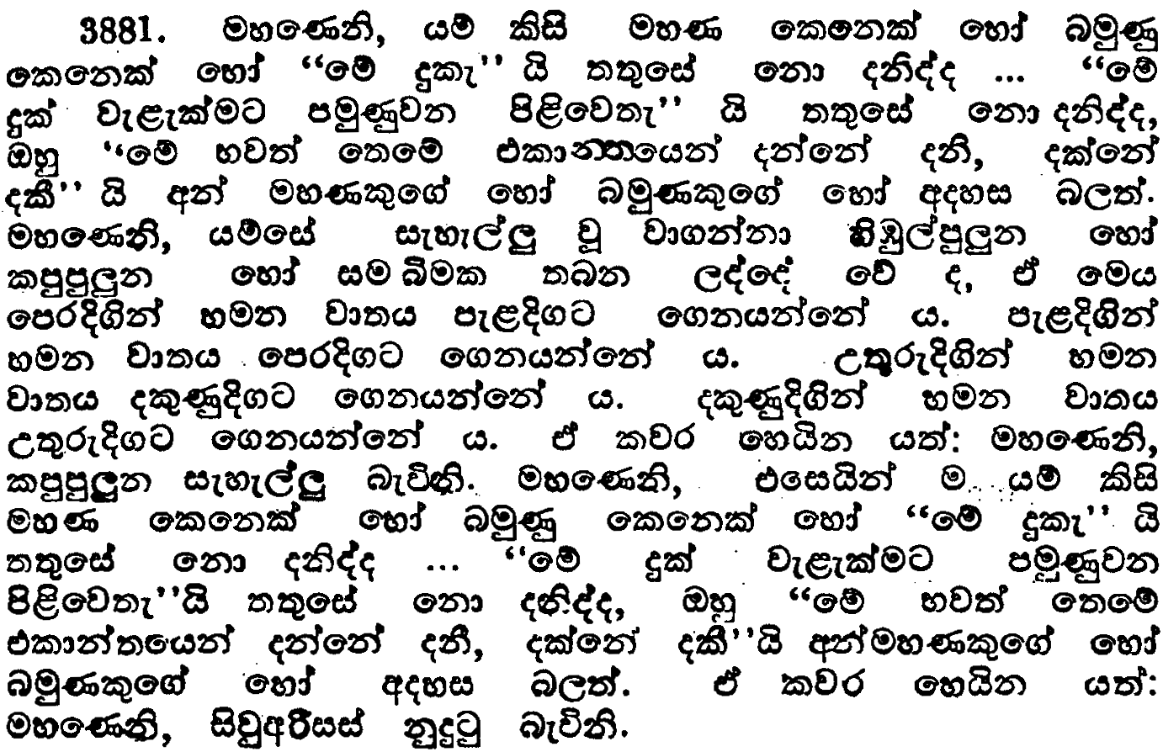
ix.ks. 5-2
bkaoÇ, iQ;%h
msgqj( 303

Slide 25
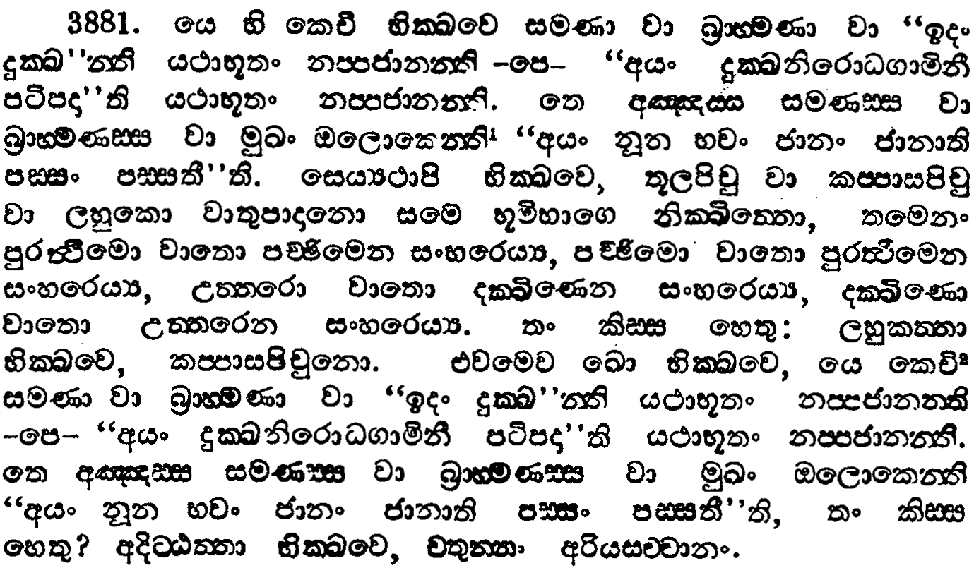
ix.ks. 5-2
bkaoÇ, iQ;%h
msgqj( 302

Slide 26
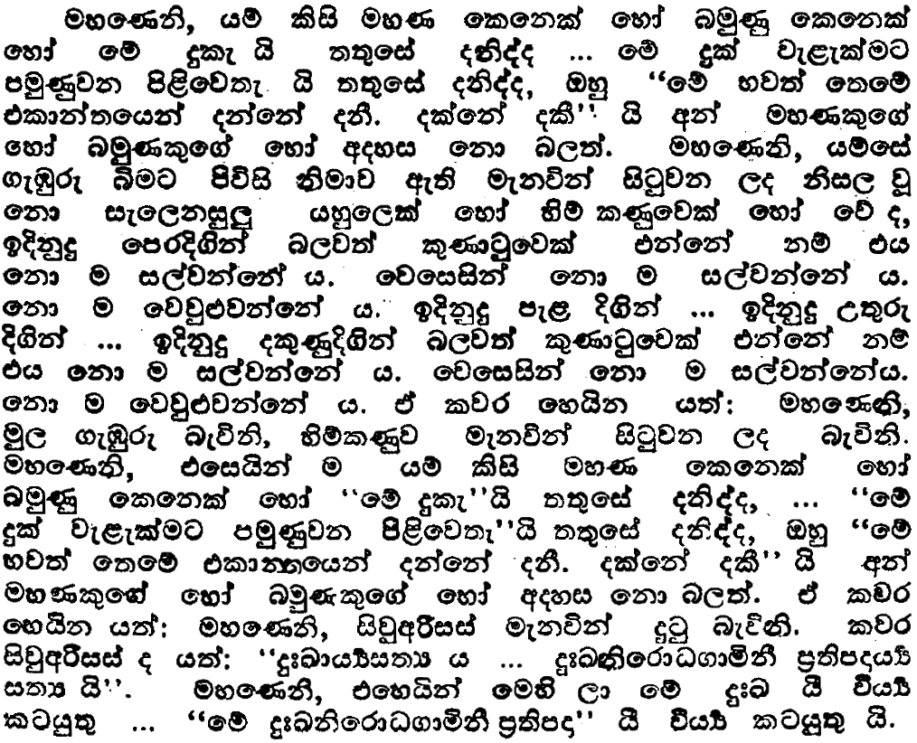
ix.ks. 5-2
bkaoÇ, iQ;%h
msgqj( 303

Slide 27
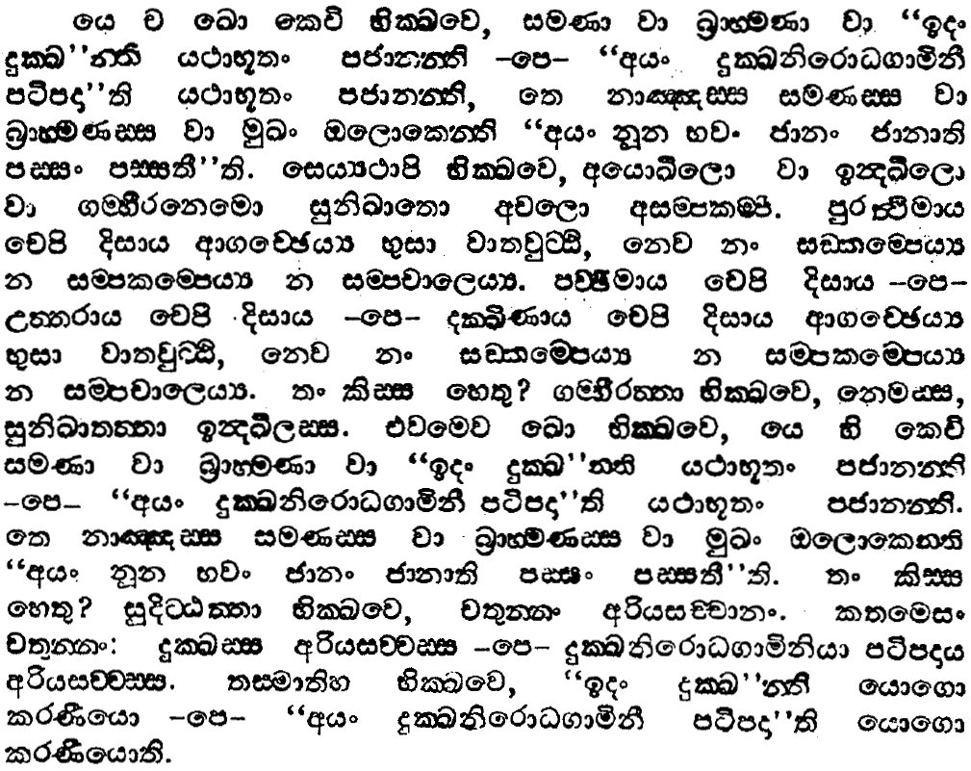
ix.ks. 5-2
bkaoÇ, iQ;%h
msgqj( 302

Slide 28
iïud osÜÀlhd bkaølS,hla fia fkdief<hs

Slide 29
f,daflda;a;r iïud osÜÀh

Slide 30
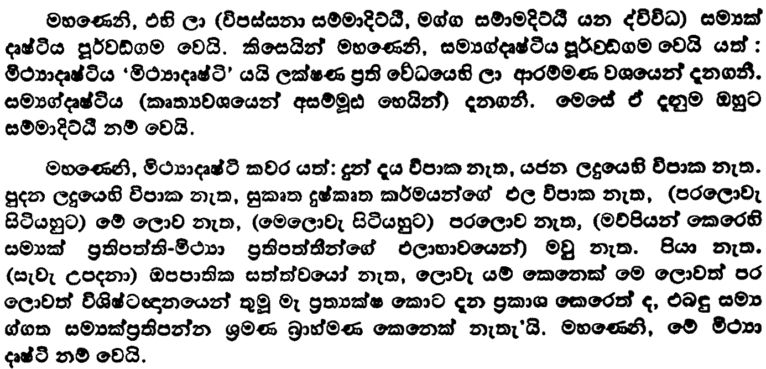
u.ks. 3
uydp;a;dÍil iQ;%h
msgqj( 213

Slide 31
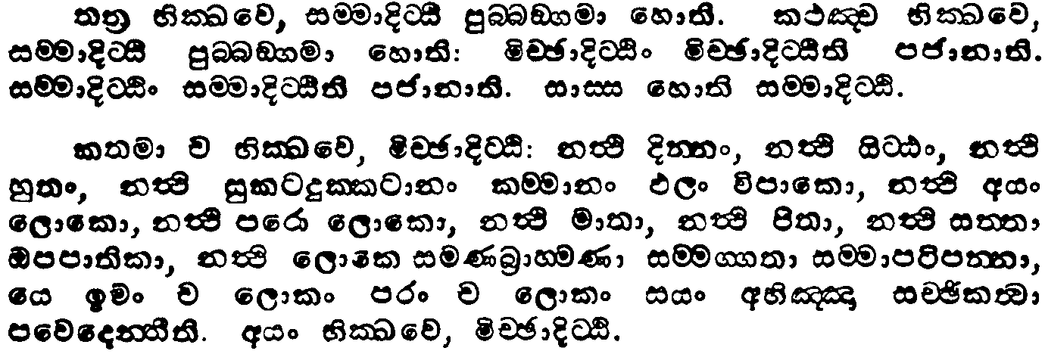
u.ks. 3
uydp;a;dÍil iQ;%h
msgqj( 212

Slide 32
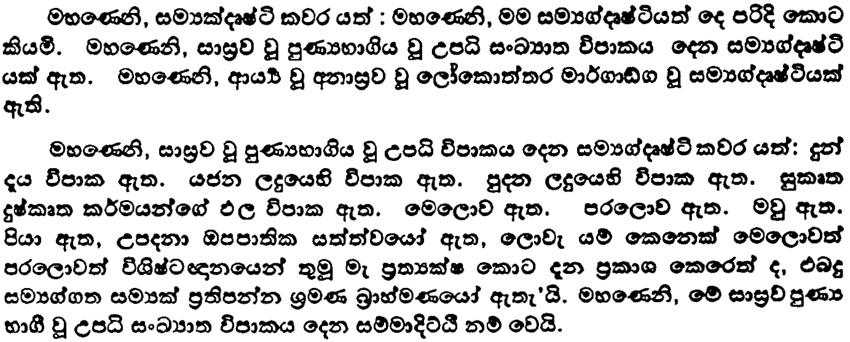
u.ks. 3
uydp;a;dÍil iQ;%h
msgqj( 213

Slide 33
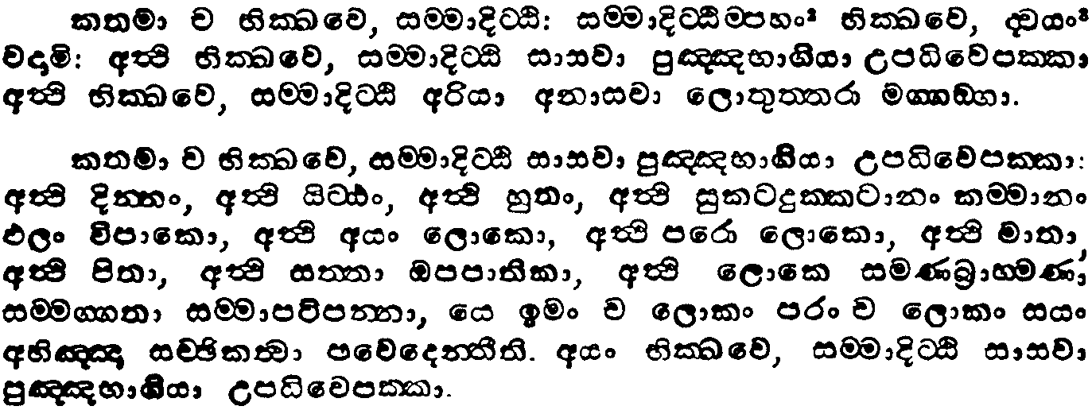
u.ks. 3
uydp;a;dÍil iQ;%h
msgqj( 212

Slide 34
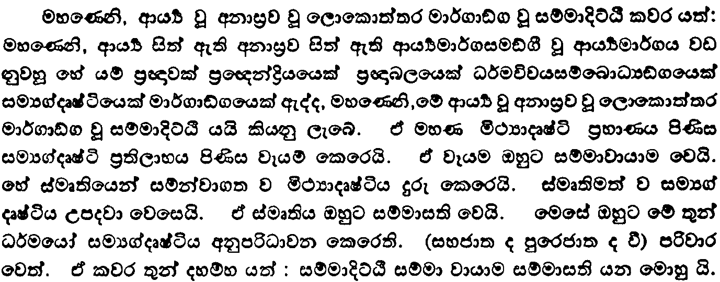
u.ks. 3
uydp;a;dÍil iQ;%h
msgqj( 215

Slide 35
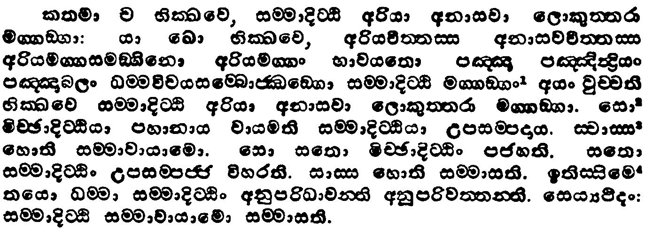
u.ks. 3
uydp;a;dÍil iQ;%h
msgqj( 214

Slide 36
O¾udjfndaOfhka m;ajk f,daflda;a;r iïud osÜÀh hkq wiaidofhys fkdne|sh hq;=hs hk oDIaÀhhs

Slide 37
iïud hkakg wre;la

Slide 38
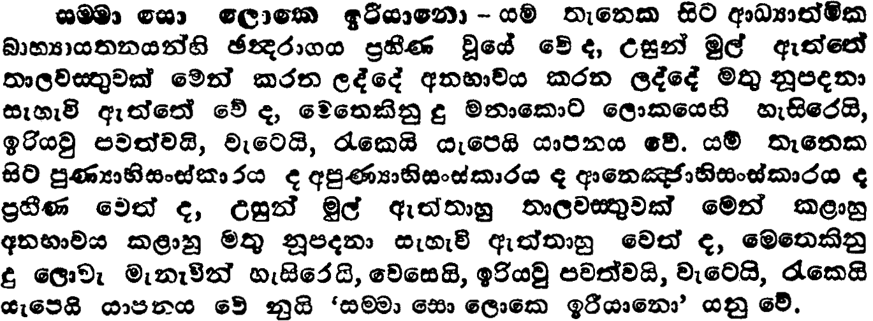
l=.ks.
uydksoafoaimd<s
msgqj( 607

Slide 39
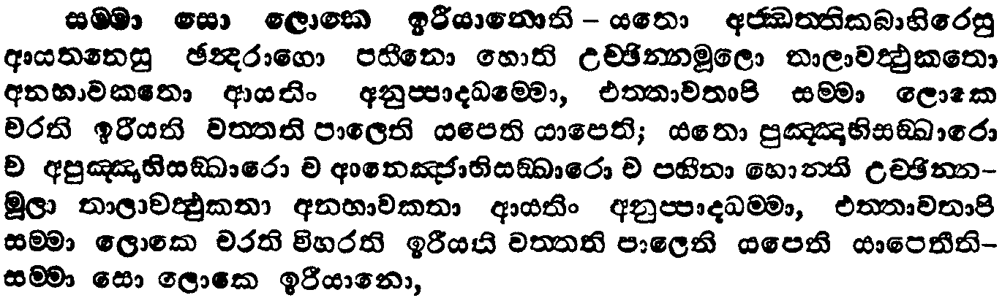
l=.ks.
uydksoafoaimd<s
msgqj( 606

Slide 40
iïud hkq wNsixldr ksfrdaOhhs

Slide 41
iïud osÜÀh we;sjk whqre

Slide 42
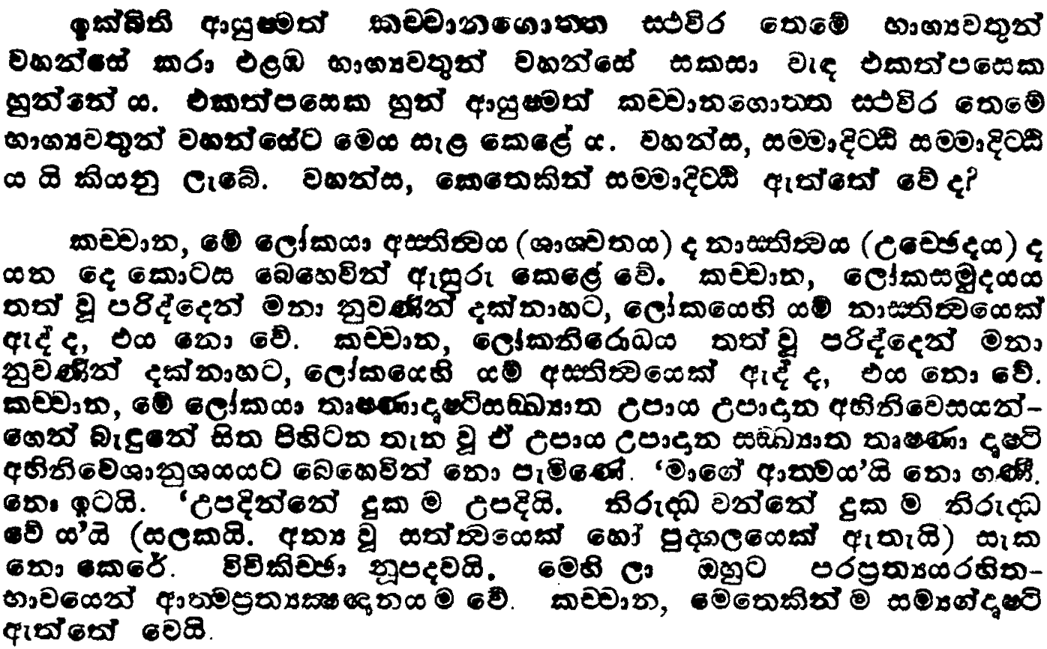
ix.ks. 2
lÉpdkf.d;a; iQ;%h
msgqj( 29

Slide 43
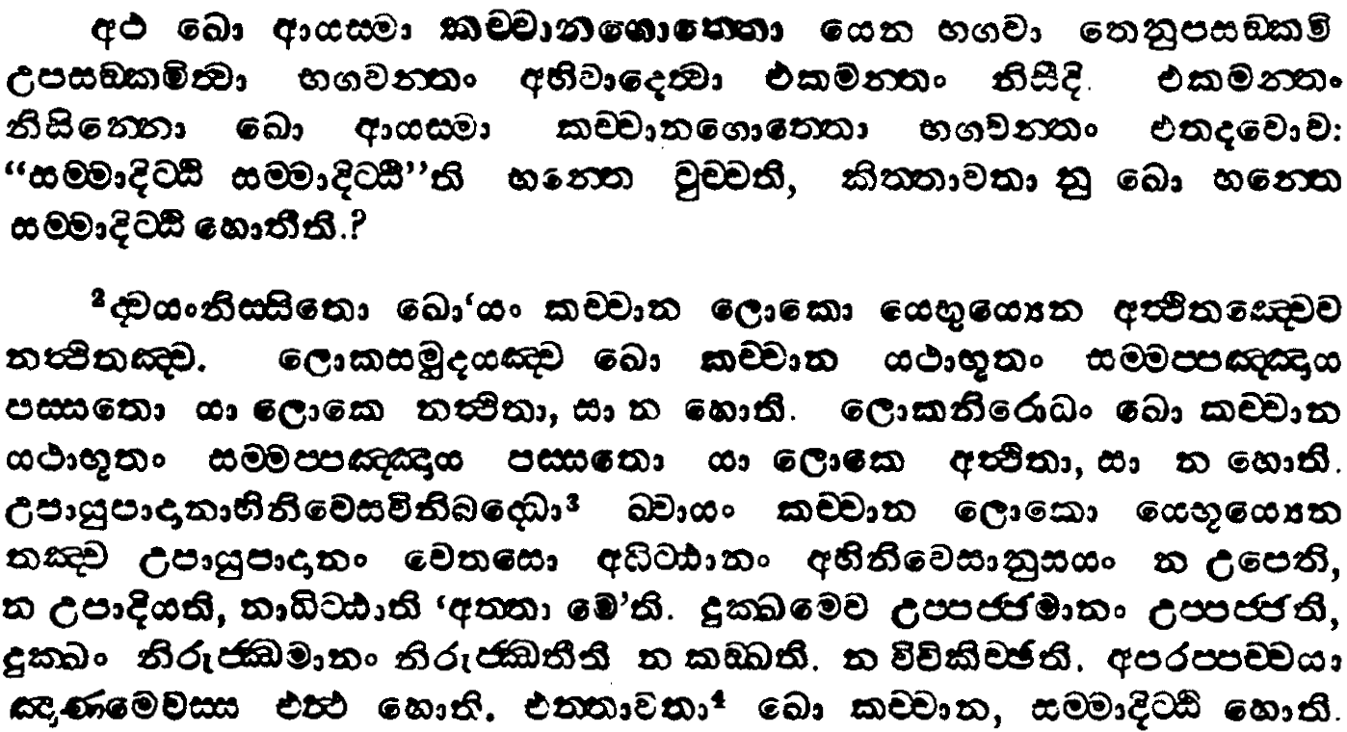
ix.ks. 2
lÉpdkf.d;a; iQ;%h
msgqj( 28

Slide 44
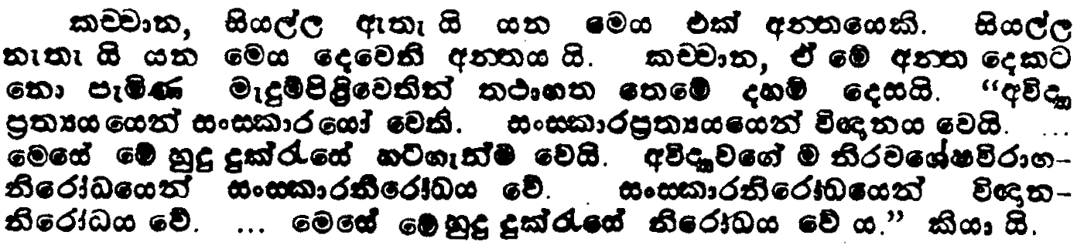
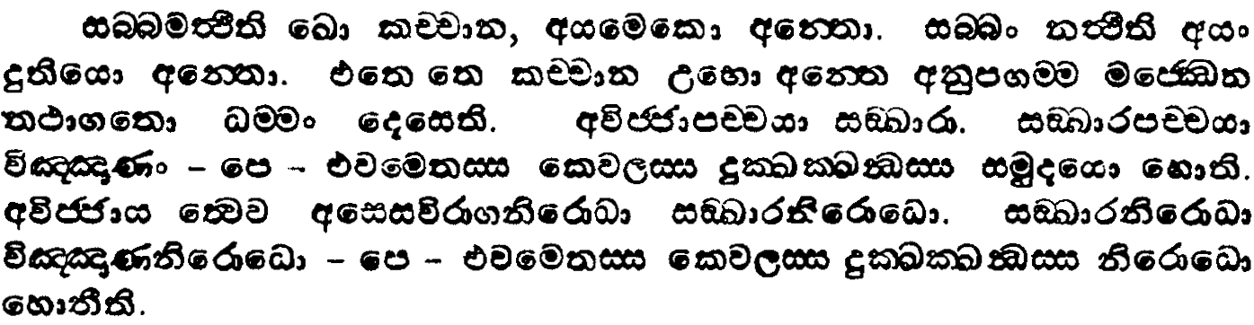
ix.ks. 2
lÉpdkf.d;a; iQ;%h
msgqj( 29/8

Slide 45
iïud osÜÀh hkq wiaidoh ksfrdaO l< hq;=hs hk {dKhhs

Slide 46
ñ:Hd m%;smodj
iy
iïud m%;smodj

Slide 47
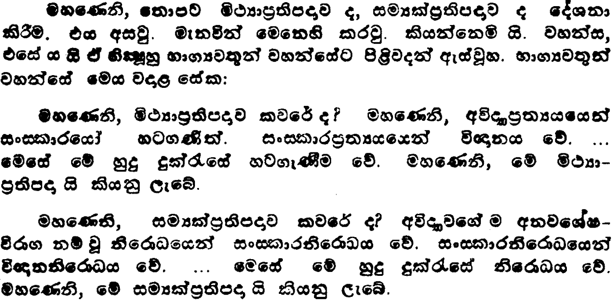
ix.ks. 2
mámod iQ;%h
msgqj( 9/8

Slide 48
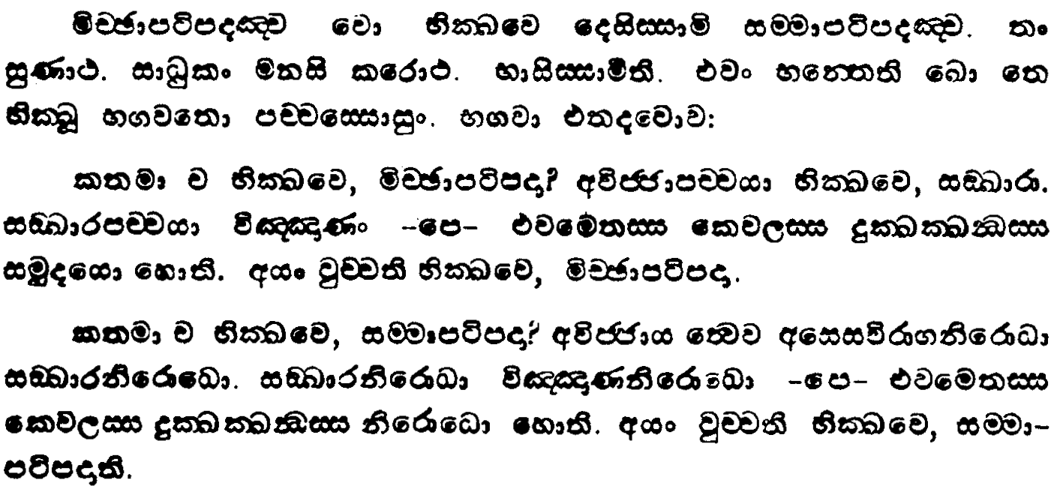
ix.ks. 2
mámod iQ;%h
msgqj( 9/8

Slide 49
iïud m%;smodj hkq wiaido ksfrdaOhhs

Slide 50
iïud osÜÀhg oelsh hq;af;a wksÉP nj

Slide 51
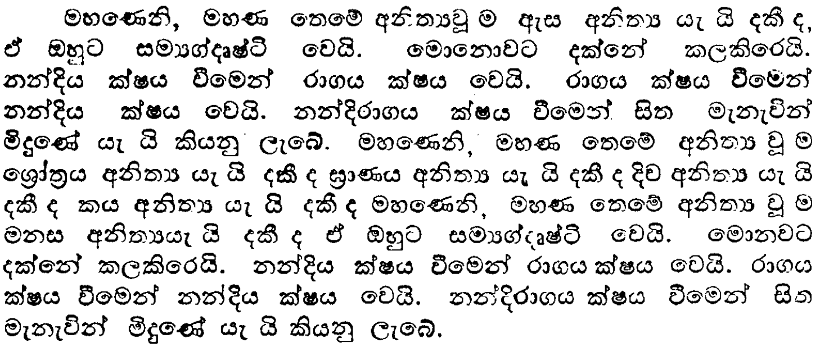
ix.ks. 4
wÊ®;a;kkaoslaLh wksÉP iQ;%h
msgqj( 283

Slide 52
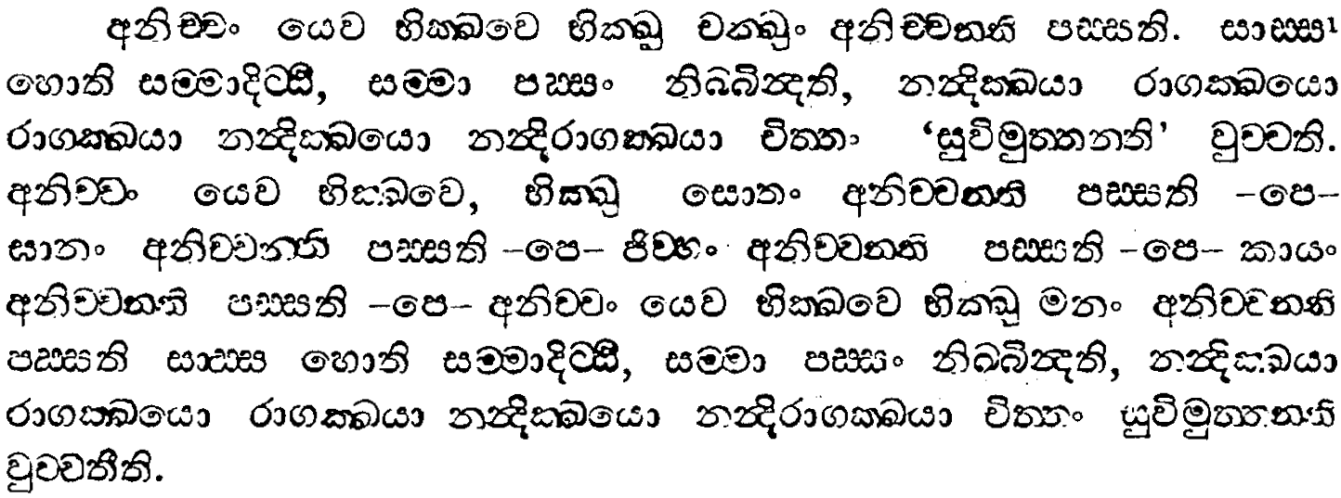
ix.ks. 4
wÊ®;a;kkaoslaLh wksÉP iQ;%h
msgqj( 282

Slide 53
iïud osÜÀh
uydi<dh;ksl iQ;%h weiqßka

Slide 54
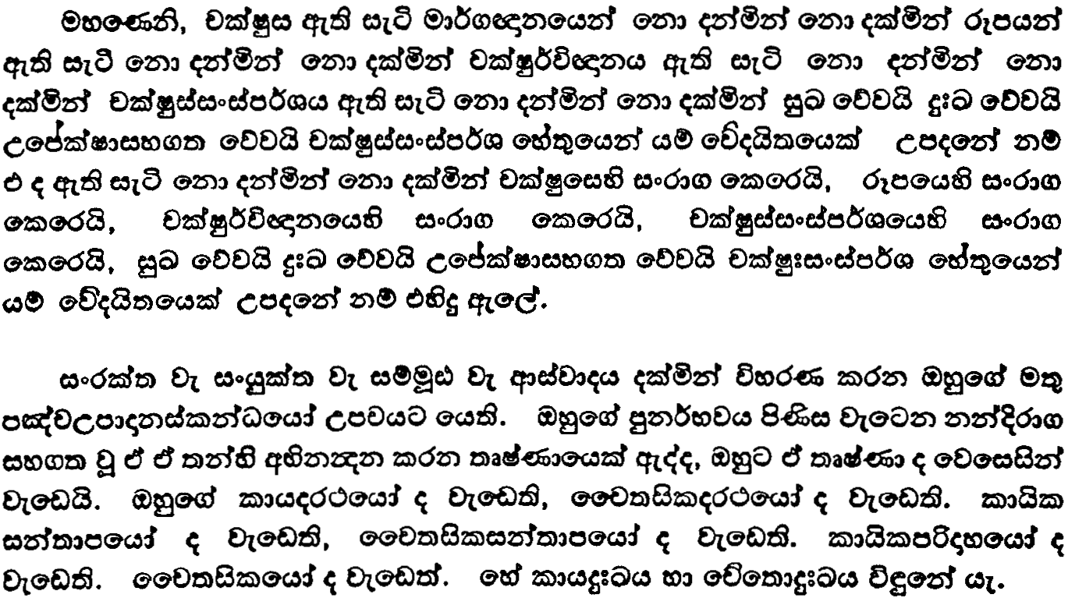
u.ks. 3
uydi<dh;ksl iQ;%h
msgqj( 595

Slide 55
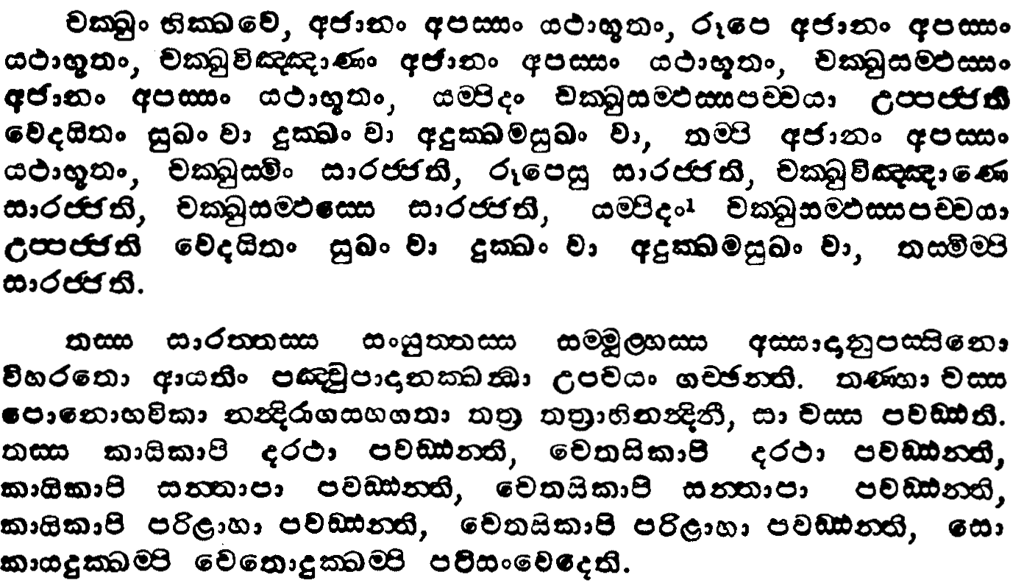
u.ks. 3
uydi<dh;ksl iQ;%h
msgqj( 594

Slide 56
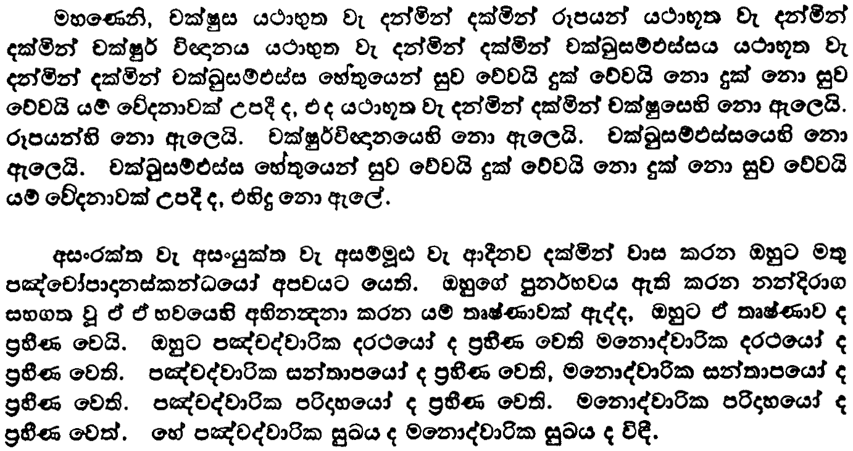
u.ks. 3
uydi<dh;ksl iQ;%h
msgqj( 597

Slide 57
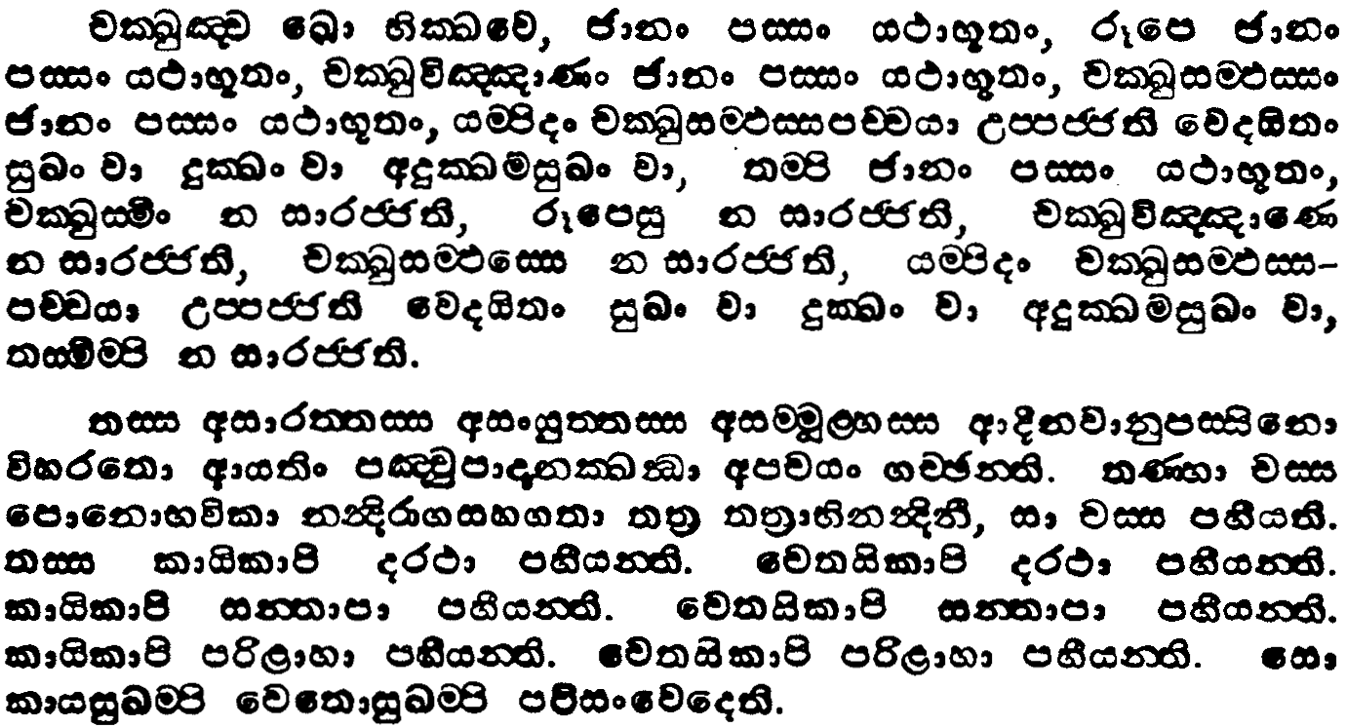
u.ks. 3
uydi<dh;ksl iQ;%h
msgqj( 596

Slide 58
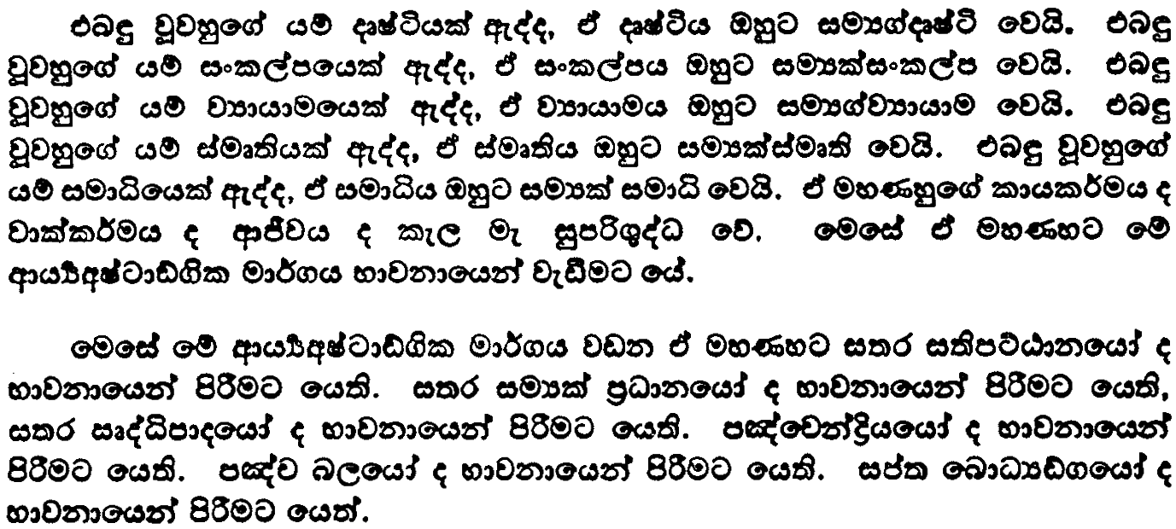
u.ks. 3
uydi<dh;ksl iQ;%h
msgqj( 597

Slide 59
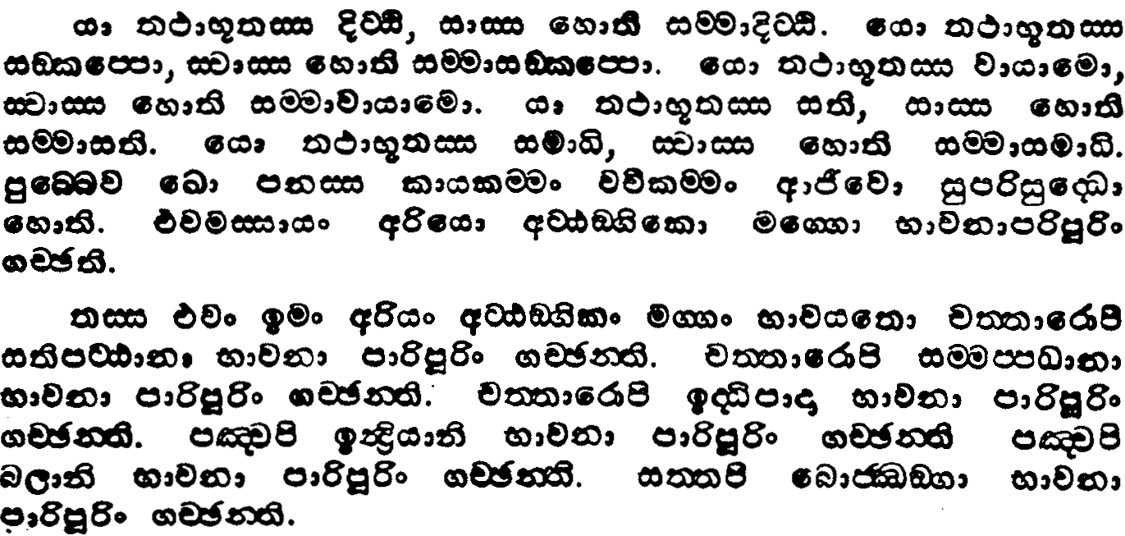
u.ks. 3
uydi<dh;ksl iQ;%h
msgqj( 596

Slide 60
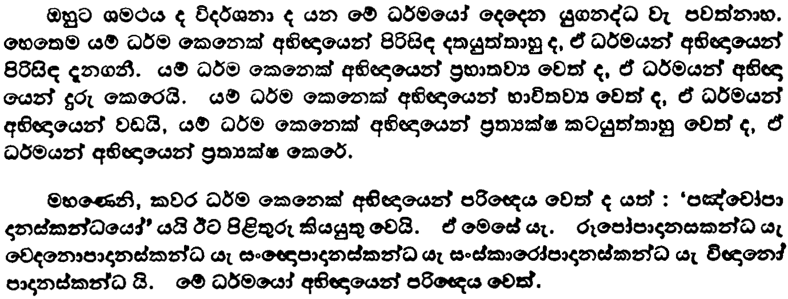
u.ks. 3
uydi<dh;ksl iQ;%h
msgqj( 597

Slide 61
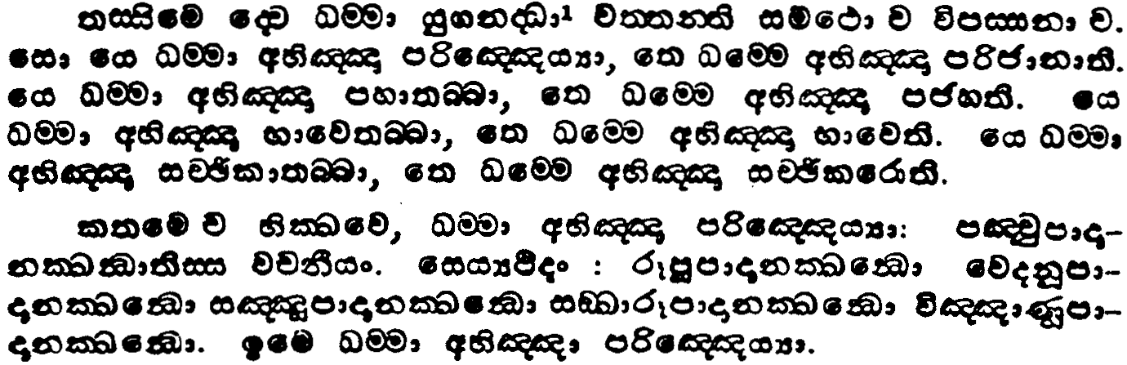
u.ks. 3
uydi<dh;ksl iQ;%h
msgqj( 596

Slide 62
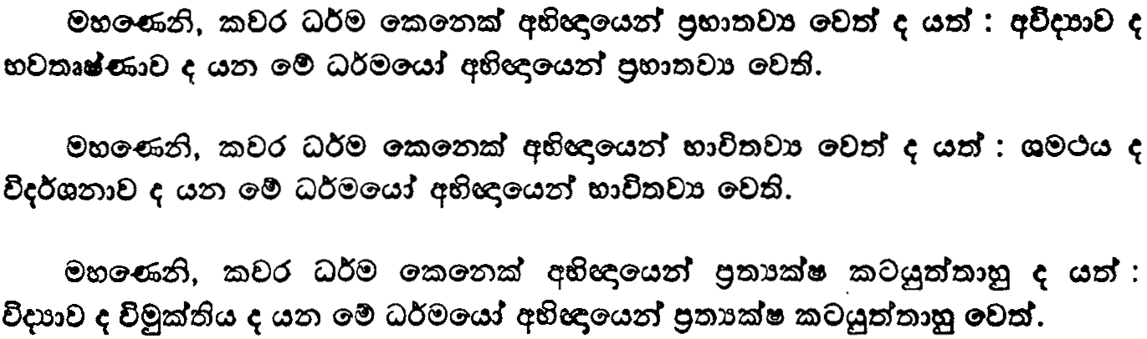
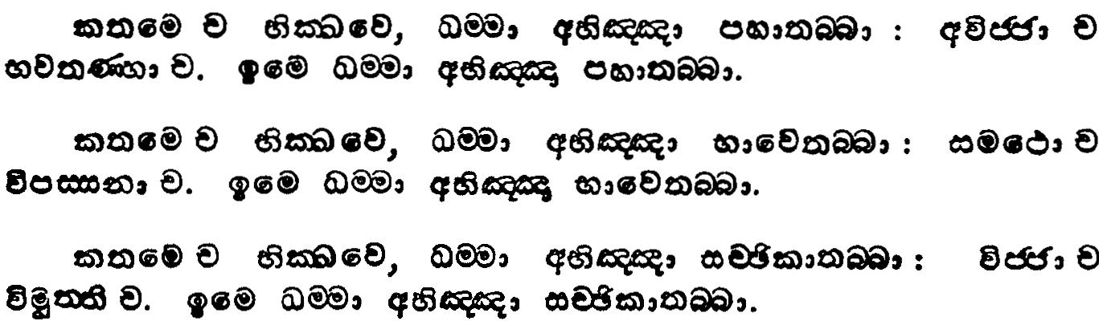
u.ks. 3
uydi<dh;ksl iQ;%h
msgqj( 599/8

Slide 63
iïud osÜÀfhka mxp WmdodkialkaOh fyj;a wiaidoh ksfrdaO fõ

Slide 64
iïud osÜÀh
iïud osÜÀ iQ;%h weiqßka

Slide 65
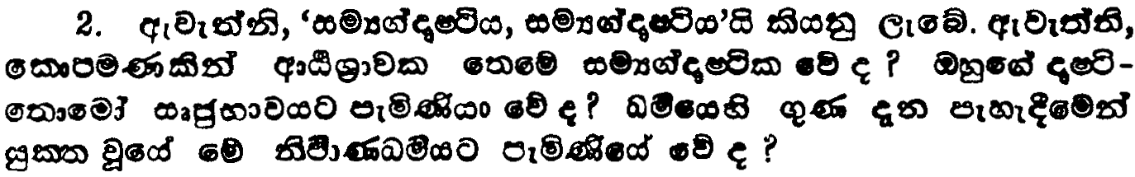
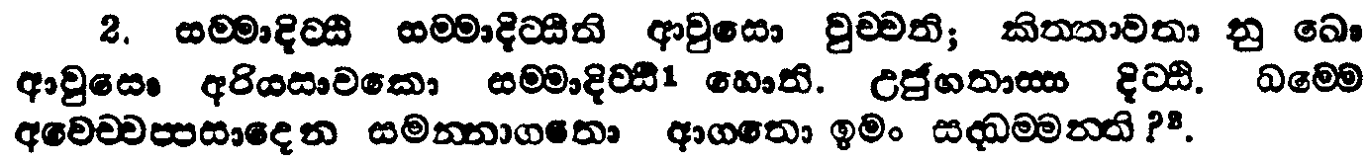
u.ks. 1
iïudosÜÀ iQ;%h
msgqj( 111/0

Slide 66
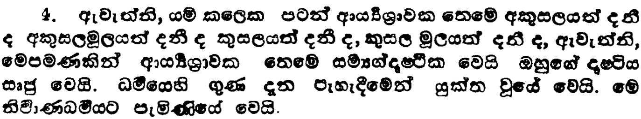
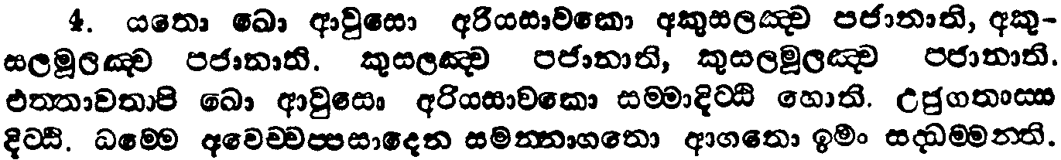
u.ks. 1
iïudosÜÀ iQ;%h
msgqj( 111/0

Slide 67


u.ks. 1
iïudosÜÀ iQ;%h
msgqj( 113/2

Slide 68


u.ks. 1
iïudosÜÀ iQ;%h
msgqj( 131/0

Slide 69


u.ks. 1
iïudosÜÀ iQ;%h
msgqj( 131/0

Slide 70


u.ks. 1
iïudosÜÀ iQ;%h
msgqj( 129/8

Slide 71


u.ks. 1
iïudosÜÀ iQ;%h
msgqj( 129/8

Slide 72
iïud hkakg ksrela;shla

Slide 73

ix.ks. 5-2
n%dyauK iQ;%h
msgqj( 31

Slide 74

ix.ks. 5-2
n%dyauK iQ;%h
msgqj( 30

Slide 75

ix.ks. 5-2
n%dyauK iQ;%h
msgqj( 31

Slide 76

ix.ks. 5-2
n%dyauK iQ;%h
msgqj( 30

Slide 77
iïud hkakg ksrela;sh
ix + ud
ñoSug nef|kj

Slide 78
iïud osÜÀ

Slide 79
u.ks. 3
uydp;a;dÍil iQ;%h
msgqj( 213

Slide 80
u.ks. 3
uydp;a;dÍil iQ;%h
msgqj( 212

Slide 81
u.ks. 3
uydp;a;dÍil iQ;%h
msgqj( 213

Slide 82
u.ks. 3
uydp;a;dÍil iQ;%h
msgqj( 212

Slide 83
u.ks. 3
uydp;a;dÍil iQ;%h
msgqj( 215

Slide 84
u.ks. 3
uydp;a;dÍil iQ;%h
msgqj( 214

Slide 85
iïud ixlmam

Slide 86

u.ks. 3
uydp;a;dÍil iQ;%h
msgqj( 215

Slide 87

u.ks. 3
uydp;a;dÍil iQ;%h
msgqj( 214

Slide 88

u.ks. 3
uydp;a;dÍil iQ;%h
msgqj( 215

Slide 89

u.ks. 3
uydp;a;dÍil iQ;%h
msgqj( 214

Slide 90
iïud jdpd

Slide 91


u.ks. 3
uydp;a;dÍil iQ;%h
msgqj( 215/7

Slide 92


u.ks. 3
uydp;a;dÍil iQ;%h
msgqj( 214/6

Slide 93


u.ks. 3
uydp;a;dÍil iQ;%h
msgqj( 215/6

Slide 94
iïud lïuka;

Slide 95

u.ks. 3
uydp;a;dÍil iQ;%h
msgqj( 217

Slide 96

u.ks. 3
uydp;a;dÍil iQ;%h
msgqj( 216

Slide 97


u.ks. 3
uydp;a;dÍil iQ;%h
msgqj( 217/6

Slide 98
iïud wdÔj

Slide 99

u.ks. 3
uydp;a;dÍil iQ;%h
msgqj( 219

Slide 100

u.ks. 3
uydp;a;dÍil iQ;%h
msgqj( 218

Slide 101


u.ks. 3
uydp;a;dÍil iQ;%h
msgqj( 219/8

Slide 102
iïud osÜÀ
iïud i;s
iïud jdhdu
iïud ixlmam
iïud jdpd
iïud lïuka;
iïud wdÔj

Slide 103

ksudj

